Slide 1


LINE and PARALLEL LINE Floral design
March 10, 2026

Slide 2
Definitions:
Parallel Design: a design in which plant material (and other components, if not prohibited) are placed in strongly parallel groupings with open space between; may be vertical, horizontal, or diagonal. Additional components may be placed at any angle at the base as connectives. Multiple containers may be used, but design must appear as a single unit. FS & JG, Book 5, p. 9.
Line Design: 1. Modern/contemporary line design: uses a minimum of plant material with emphasis on contrast in form and texture. ● There may be more than one point of emergence for plant material ● There may be straight or curvilinear, diagonal, and/or radial lines. 2. Traditional line design: the element of line predominates and emphasized by a restrained use of plant material; silhouette is open; voids exceed solids.
Line-Mass Design: directional line may be horizontal, vertical, or diagonal. 1. Modern line-mass design: bold and dramatic designs that may have more than one point of emergence of plant material. Components may emphasize contrast of texture, color, and line. 2. Traditional line-mass design: blending mass and line designs with an open silhouette; voids equal to solids; usually asymmetrical with a rhythmic flow. FS & JG, Book 5, p.8.

Slide 3
April is Blooming with Conservation!
(GCA Judges)
“To leave the world better than you found it, sometimes you have to pick up other people’s trash.” — Bill Nye
Class 1 (4) Entries
Earth Day 2026 - Create a Parallel Design.* Use recycled material for your container and/or accessories; Multiple containers are permitted. Staged on the Riverhouse’s 42” high wooden bar with lip. A 26” high white cloth backdrop and a staging space of 24” width x 18” depth are provided for each design. Viewed and judged from three sides. A Title or Statement of Intent is required.
Class 2 (4) Entries
Novice. Same as above.
“In nature, nothing is perfect and everything is perfect. Trees can be bent, contorted in weird ways, and they’re still beautiful.” – Alice Wade
Class 3 (4) Entries
Arbor Day 2026 - Create a Parallel Design* expressing important elements or features of a tree. Multiple containers are permitted. Staged on the Riverhouse’s 42” high wooden bar with lip. A 26” high white cloth backdrop and a staging space of 24” width x 18” depth are provided for each design. Viewed and judged from three sides. A Title or Statement of Intent is required.
Class 4 (4) Entries
Novice. Same as above.
Pre-registration is required by Sunday, April 19. Class consultant, Louisa Renn, louisarenn@gmail.com. Exhibitors may enter one class only.

Slide 4
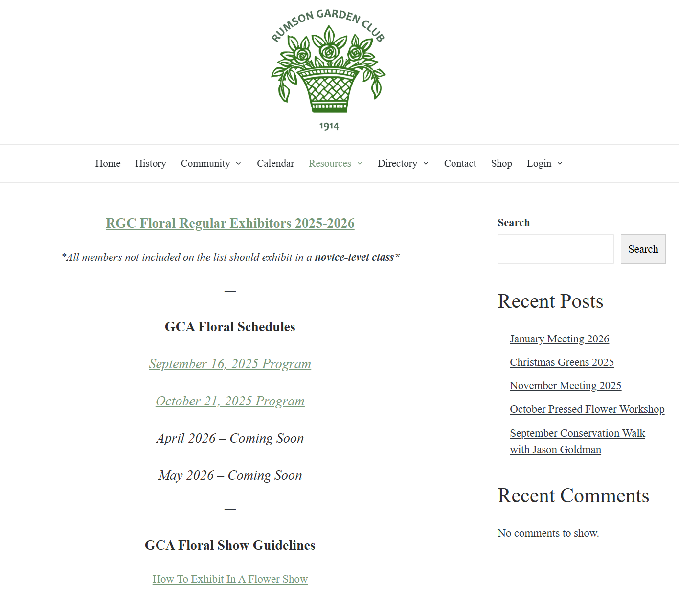
FLOWER SHOW PROGRAM GUIDEs and
GCA Floral schedules
For each RGC Flower Show where GCA Judges are involved, a 10+ page guide will be published on the RGC Website, rumsongardenclubnj.org.
Log in. Flower Show Programs are located under the “Resources” tab.
The GCA Floral Schedule is your “go-to” place to have all questions answered about what is allowed in a show and what is not. Call the class consultant listed for the Show if you need additional assistance.
BEFORE YOU START DESIGNING, READ IT CAREFULLY!

Slide 5
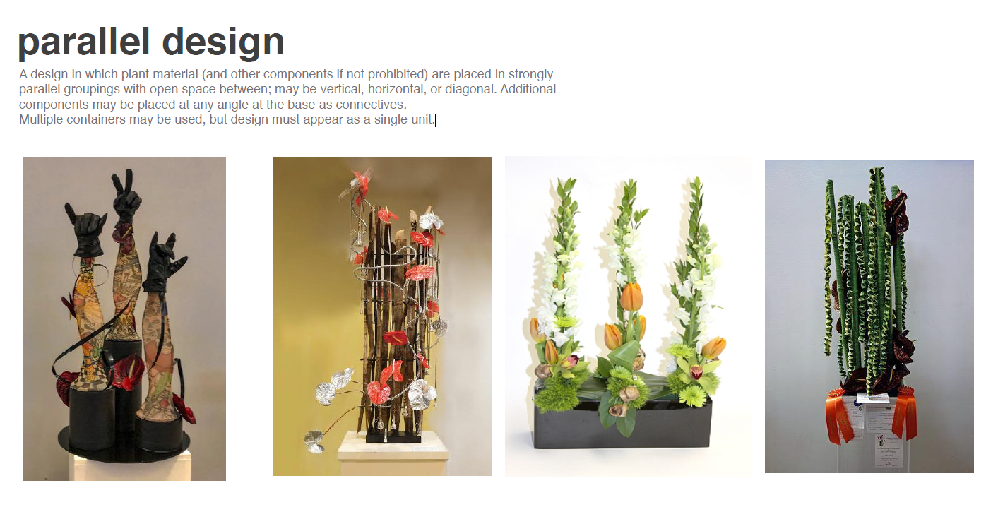
The following 5 slides are from GCA - Photo Library Design Syles Power point and Floral Design Course FD-201

Slide 6
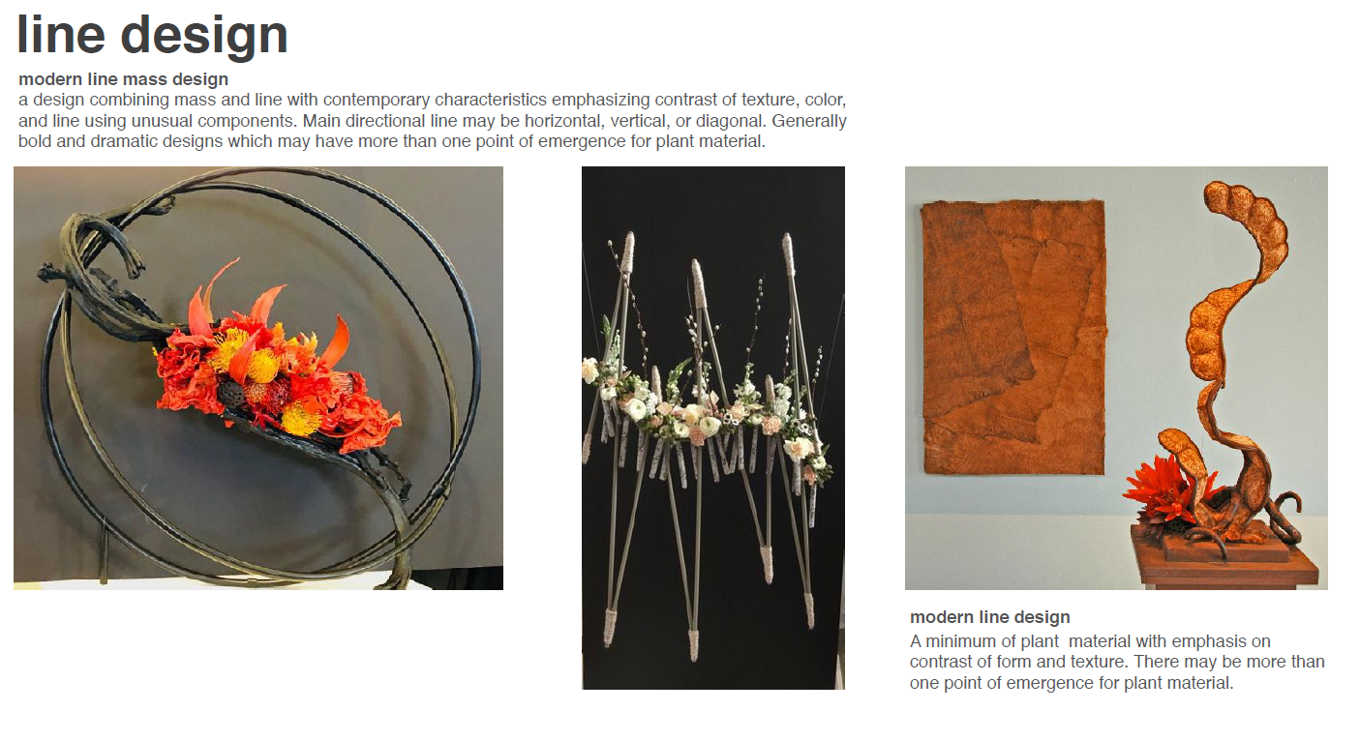

Slide 7
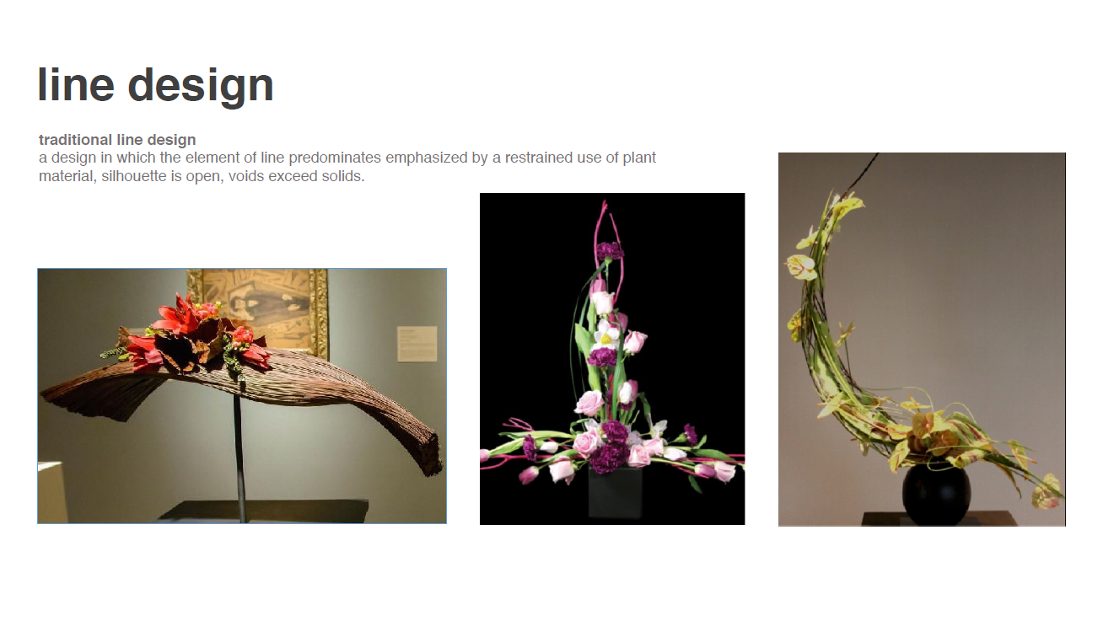

Slide 8
Note: The red platter on which the three green vases rest unifies the design into one unit. For the recycling challenge, vase(s) might be aluminum cans or interesting glass jars.

Slide 10
Helpful Hints & Resources:
• Key search words on Pinterest and Google images specifically for the April challenge: “parallel floral design ideas”, “line floral design arrangements”, “floral design with wood”, “floral arrangements with recycled materials.”
• Parallel design arrangements have greater focus on framework or armature. Building structures take TIME! Start early and do not wait until the last minute. Mechanics should not be visible unless they are an integral part of the design.
• Sustainable and GCA approved mechanics / tools for holding designs together – chicken wire, Kenzans / floral frogs, Hairpin holders (looped wire instead of sharp needles), ceramic frogs, domed or grid cages. Floral foam is not allowed in a GCA flower show.
• FOLLOW Flower Show Junkie! on Instagram. Liz Wozencraft, Houston, TX GCA member and GCA Judge, posts pictures of flower show entries from all across the country. Even RGC shows are sometimes shown on her site! Followers can get inspiration and learn by reading judges’ comments to learn how they think. Check out a picture of one of Barbara Batting’s winning floral design entries which is gracing the cover of GCA’s article this month on the Flower Show Junkie.

Slide 11
WET OR DRY?
• Think about water sources for plant material. Incorporate water tubes into armature, if you can. Select fresh flowers that don’t require much water or consider using high-interest or colorful foliage instead. Dried plant material is allowed though plastic or artificial is NOT! Fruit (and cut fruits) are allowed if properly preserved. Whatever you use, condition well. Floral preservatives are helpful. Keep in a cool location to extend life. If entering a flower show that might run several days where watering might be difficult, consider using dried plant material.
GCA does NOT require water per se. Per GCA, “All entries must include fresh and/or dried plant material. Fresh plant material must be in water or conditioned in such a way as to remain in pristine form while on exhibition. Rooted plant material is allowed provided no soil is attached with the exception of a pot-et-fleur class.”
• Possible flowers to use in no, or low, water situations:
Anthurium – Flamingo lily Eryngium – Sea Holly
Orchids, Succulents, Allium, some Tropicals Limonium - Statice or Sea Lavendar
Protea - Sugarbush Celosia – Cocks Comb
Achillea Millefolium - Yarrow Chamelaucium - Wax Flower
Asteraceae - Chrysanthemum Amaranthus – Love-Lies-Bleeding
Zantedeschia - Calla lily Leucadendron - Conebush
Scabiosa – Pincushion Flower Strelitzia - Bird of Paradise
Gypsophilia – Baby’s breath Gomphocarpus – Ballon Flower or Hairy Balls
Craspedia – Billy Buttons

Slide 12
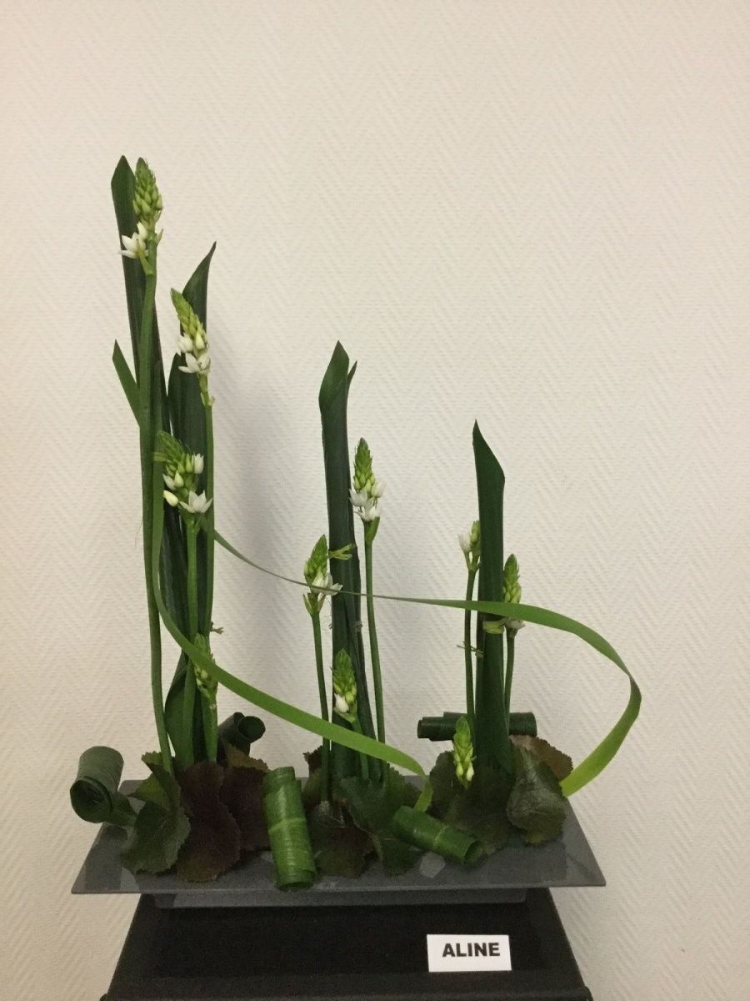
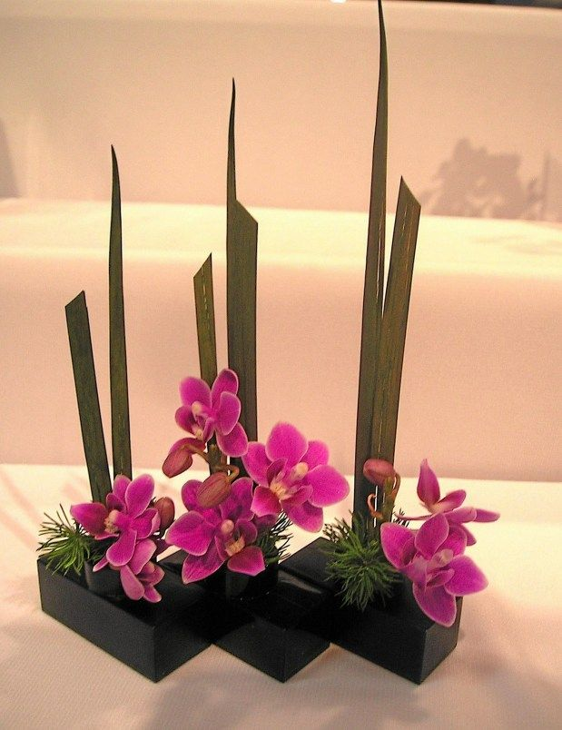
The remaining slide deck pictures were found on Pinterest or on Google Images and are to be used for discussion and inspiration.
Similar designs– both have strong vertical elements and dark bases; Left Design angles high to low, single black base, has uniform and dominate green color palate; Right Design angles low to high, 3 connected black bases, strong accent color.

Slide 13
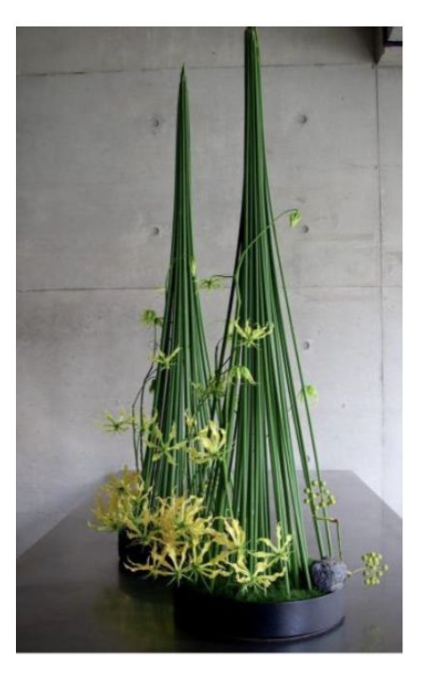
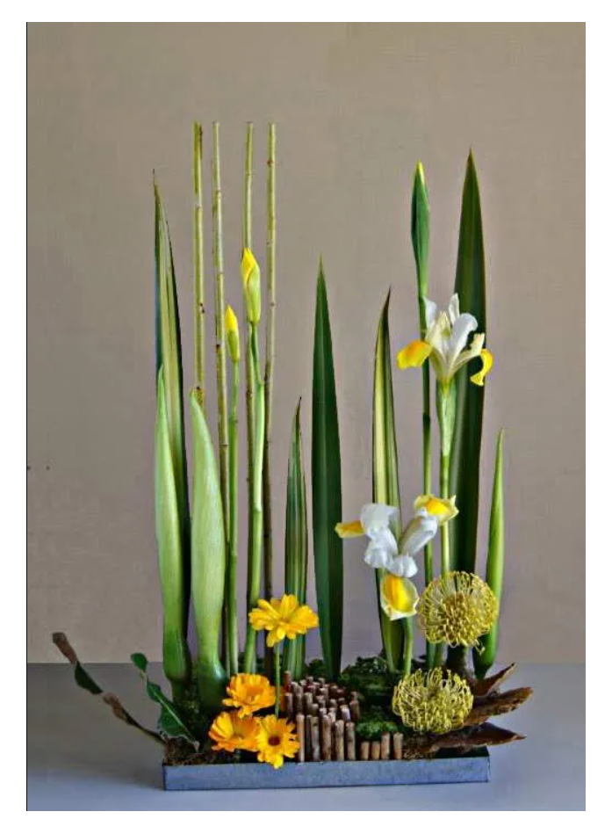
Left Design: Interesting vertical lines, separation of structures creates parallel design, floral material compliments but doesn’t over-dominate. Right Design: nice vertical lines and plant material, would recommend more negative space in the center of the arrangement to create two or more distinct groups for a parallel design style… not just a line design.

Slide 14
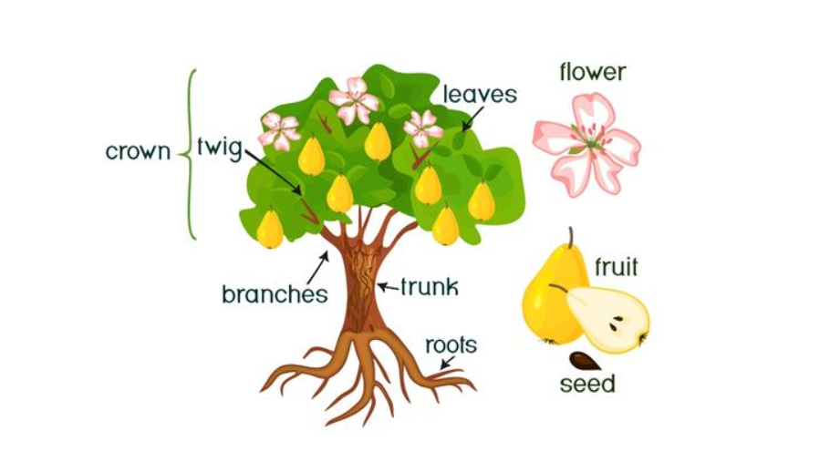
April Floral Design Challenge for Class 3 and Class 4
Arbor Day 2026 - Create a Parallel Design expressing important elements or features of a tree.
or acorn, nut, or pinecone
bark

Slide 15
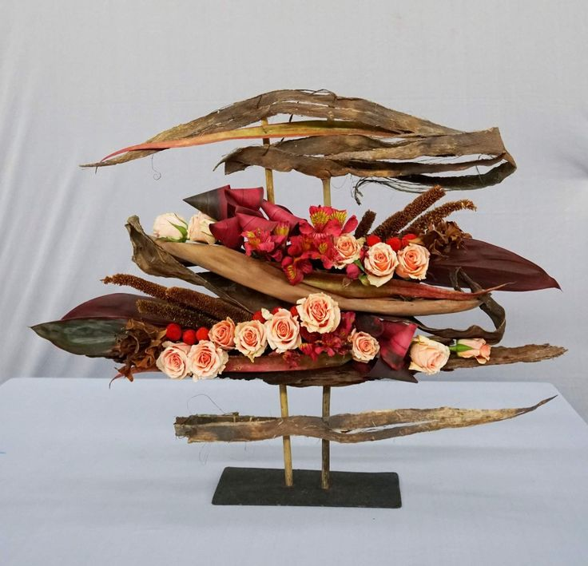
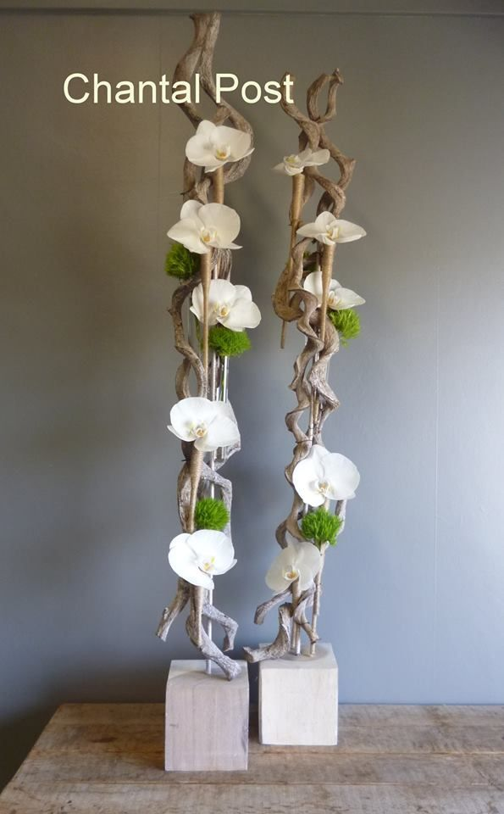
Water tube covered with twine.
Left Design: Nice mixture of plant to “tree” material, however peach roses could be placed a little more horizontally and are circular in shape – not my favorite choice of flower. Would add more negative spacing to accentuate parallel features.
Right Design: Nice use of curvy dried branches or driftwood; excellent mechanics to cover water tubes holding the orchids. Placement of blocks a little off center from each other is nice. Clear PVC tubes could also be used so design “floats.”

Slide 16
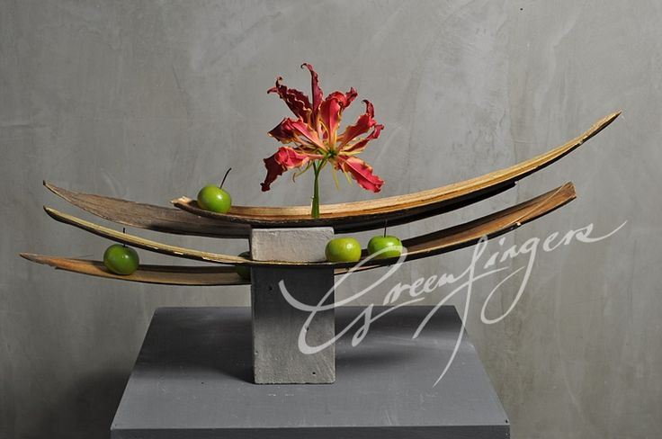
Would consider creating just a little more space between the wooden layers. The lily adds pizzaz but creates a “bulls-eye” that some judges might feel is too dominate -- stopping the rhythm of the overall horizontal nature of the design. The design might be less successful if the base and background were not uniform neutral colors. How a designer treats the base and background matters!

Slide 17
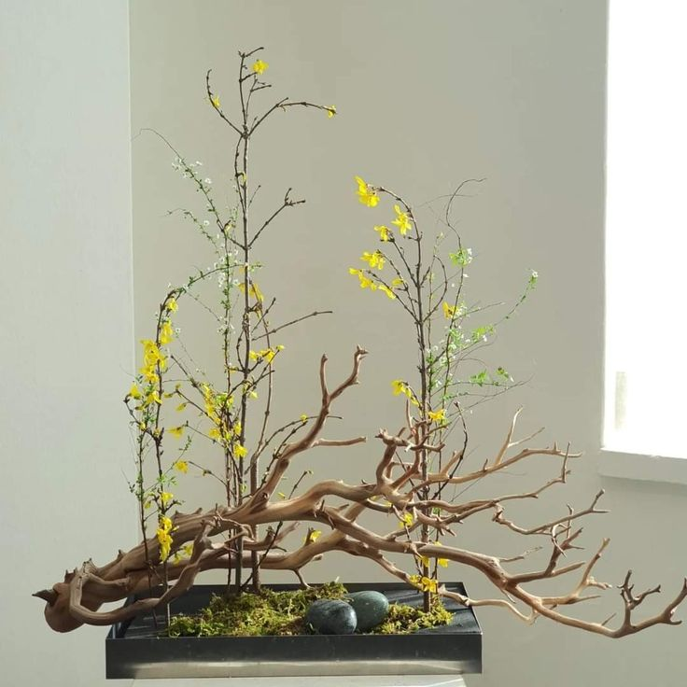
The intent of this designer may have been to create a vertical parallel design of two-three groupings of forsythia. Adding the lower branch grounds and provides interest, however, this wooden branch is overly large. Because it leans horizontally, it competes with the vertical lines of plant material. A smaller branch or vertical branches might be worth considering.

Slide 18
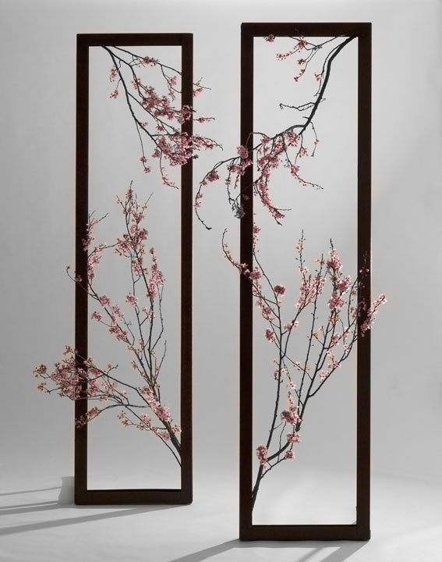
Has strong parallel lines from the black vertical frames; good interpretation for April’s “tree” challenge; Excellent use of negative space. Elegant and artistic.
The frames are intentionally placed diagonally - one slightly in front of the other - which is more pleasing to the eye than just side-by-side. Even shadows add to overall lovely effect of this parallel line design.

Slide 19
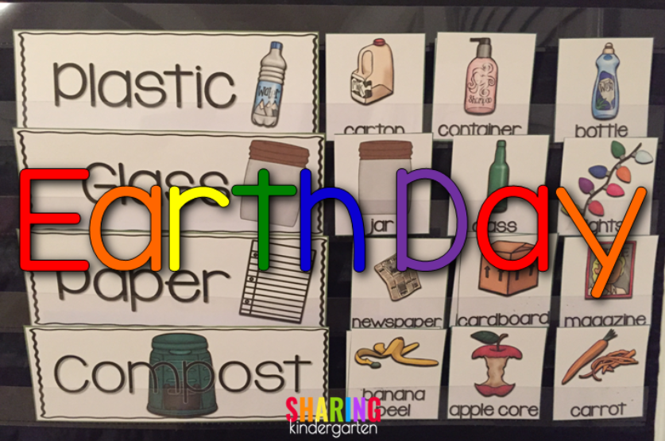
April Floral Design Challenge for Class 1 and Class 2
Earth Day 2026 - Create a Parallel Design. Use recycled material for your container and/or accessories.
Newspaper, cardboard, plastic bottles and containers, magazines, wire, metal scraps, tin cans, glass, etc… are all possible items a designer might use as a container, an accessory, or as the armature for April’s challenge to commemorate Earth Day.

Slide 20
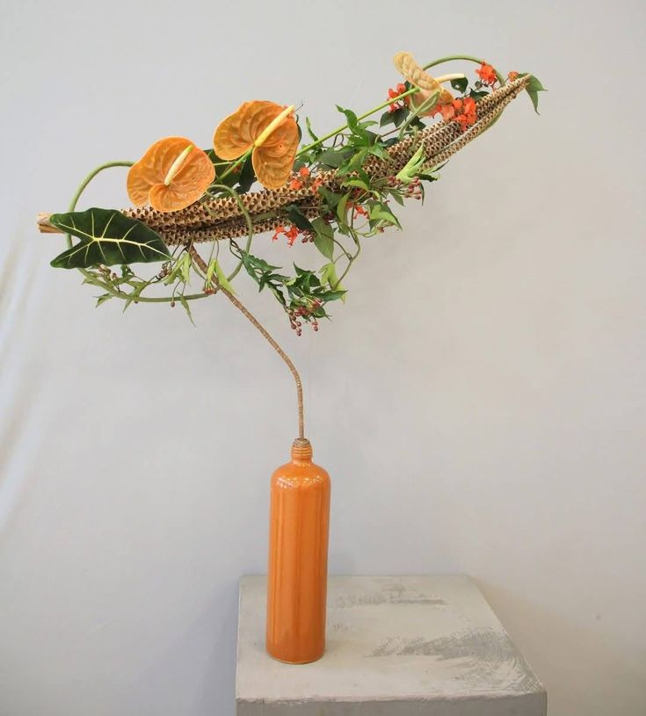
You are inspired by a picture but what if it’s not a parallel design arrangement?
To the left is a striking line design with elegant use of painted glass bottle and gorgeous placement of complementary plant material.
To convert an arrangement like this into a parallel line design, a “mother-daughter” approach might work. Add a second similar, although shorter piece, next to the original and place the second container slightly in front of the first at an angle so that lines of the plant material are parallel.
A tan or an orange matting could be placed under the vases to pull the base components together.

Slide 21
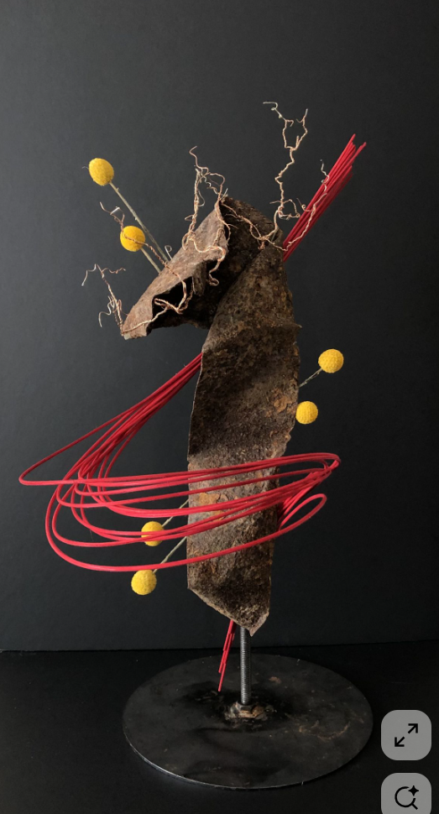
This design appears to be an old piece of dirty paper wrapped with curvy red midollino sticks and bold yellow billy buttons. No water needed! A designer could also use an old metal scrap or clear or painted plastic piece as the centerpiece. To make parallel, designer could place commentary vertical design beside one another.

Slide 22
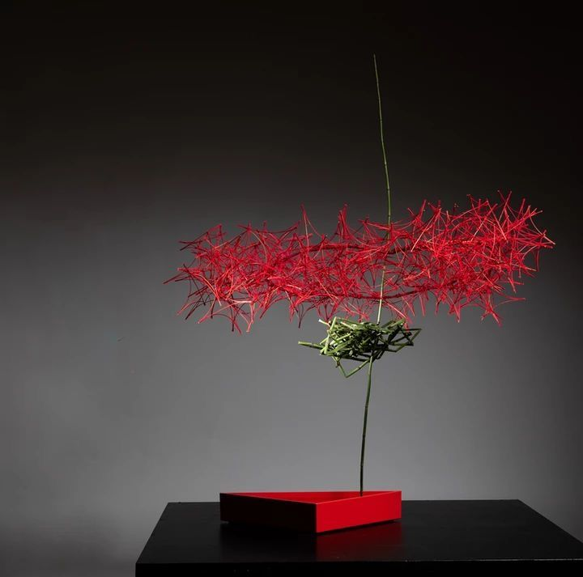
Great color and horizontal parallel lines. Red material could be constructed out of wire, mesh, netting, or other discarded recycled material.
Green shoot appears to be a reed or bendable stem of some sort. Check the invasive’s list to confirm material you are using is allowed. The painted triangular base is striking with red and black.
At Riverhouse, arrangements will be placed 42” high on a dark glossy teak bar with a white cloth background. Designers are allowed to bring different backgrounds to better accentuate or present their entry.

Slide 23
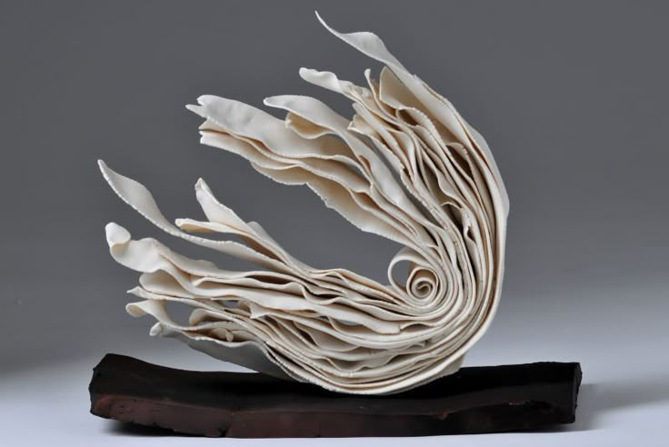
PAPER ART & Amature building: Use wire, chicken wire, or aluminum foil, masking tape, and cardboard to create the initial structure, then cover with newspaper or magazine paper mache strips. Recycled fabric could also be used to create the form. When dry and painted, add floral material to complement the design.
To make paper mache mixture, you'll need paper strips and a paste made from flour/water or glue/water, then layer the strips onto a base (like a balloon) and let it dry to create a hard form, perfect for painting. The flour paste (1 part flour to 2 parts water) can be microwaved for a thicker consistency, while a glue paste (1 part glue to 2 parts water) dries harder. Tear newspaper into strips, dip them in the paste, remove excess, and layer onto your chosen form until covered.

Slide 24
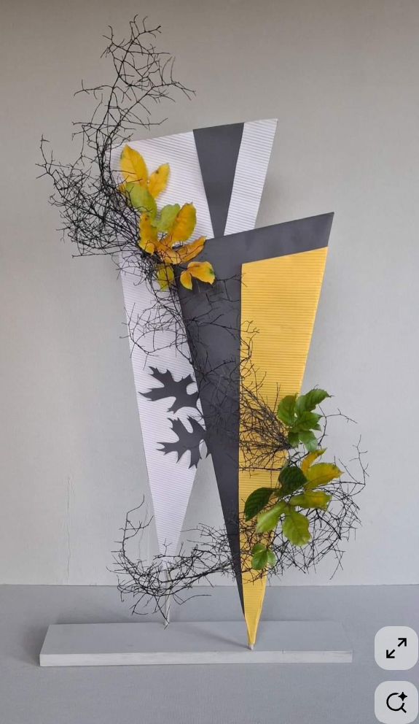
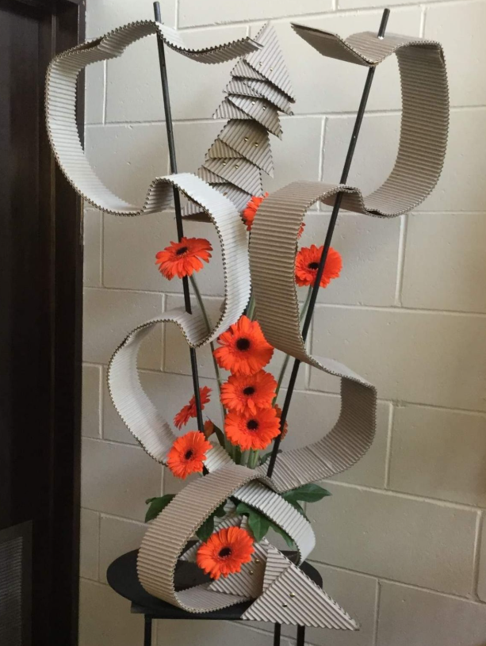
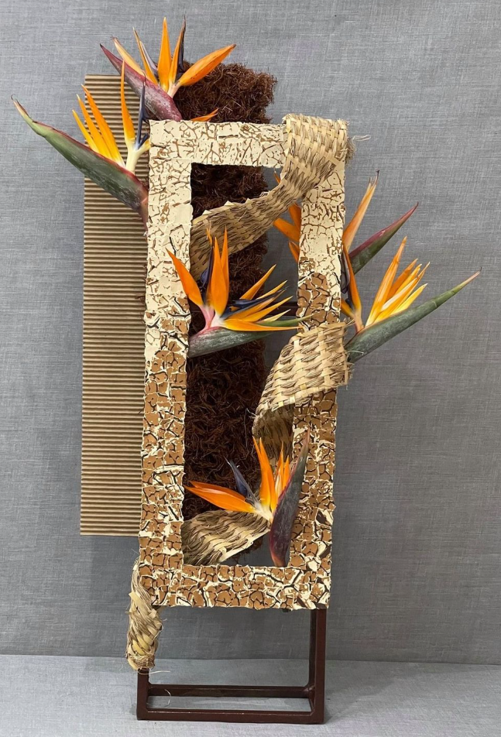
CARDBOARD ART

Slide 25
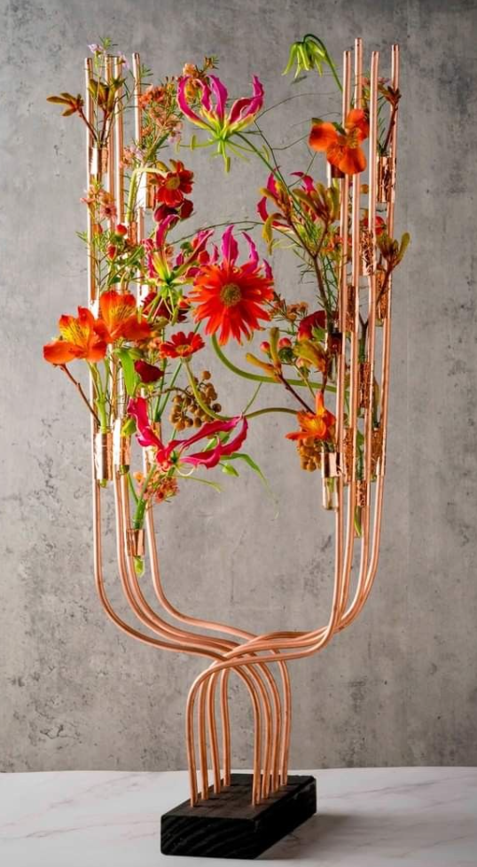
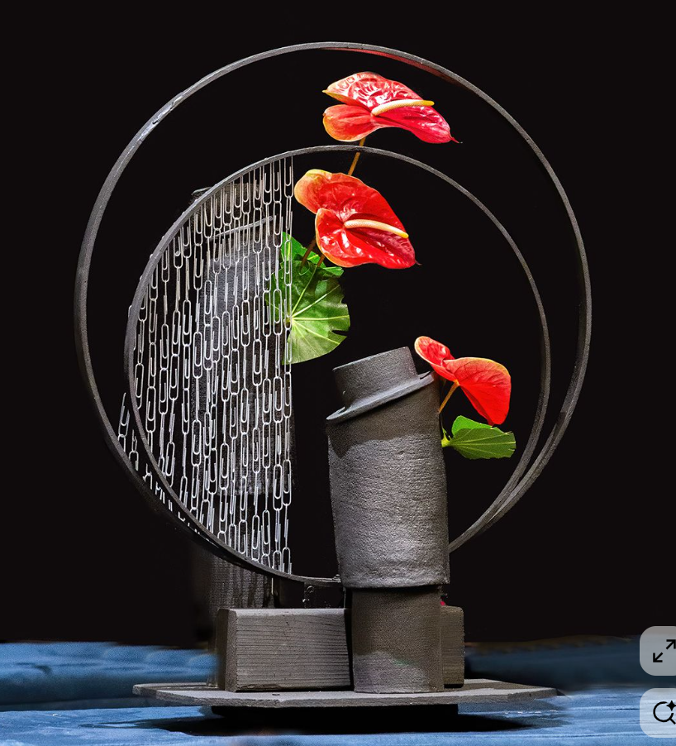
WOOD and METAL
Notice the copper covered water tubes!

Slide 26
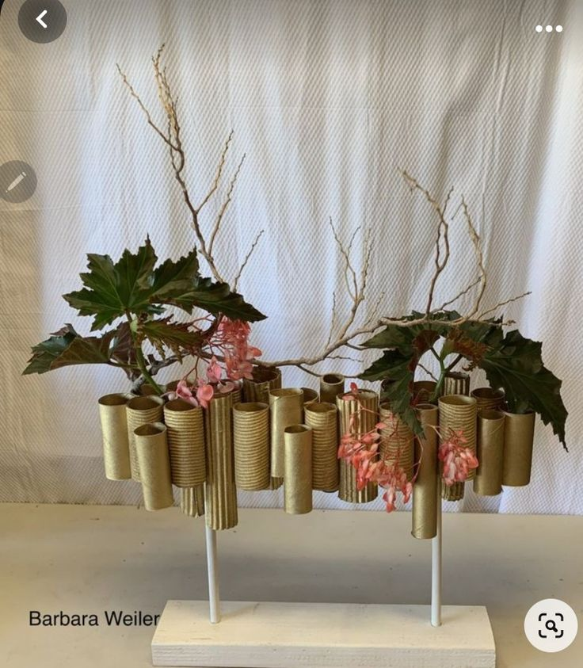
COULD THIS BE BETTER?
For a vertical parallel design, the designer could remove some of the gold tubes from the center of the design to create two district groupings. Plant material and branches could be more vertical in nature. Water sources can be discreetly hidden within the elevated tubes.
For a horizontal design, two horizontal rows of gold tubes could be constructed. Floral material could be draping and flowing over tubes or use flowers or material which can be wired and manipulated to lay horizontally.
Tip - Several flowers that are easy to manipulate by inserting wire into a flexible stem or gently massaging stems to the desired angle are the Calla Lily, Tulip, Gerber Daisy, and Lenten Rose.

Slide 27
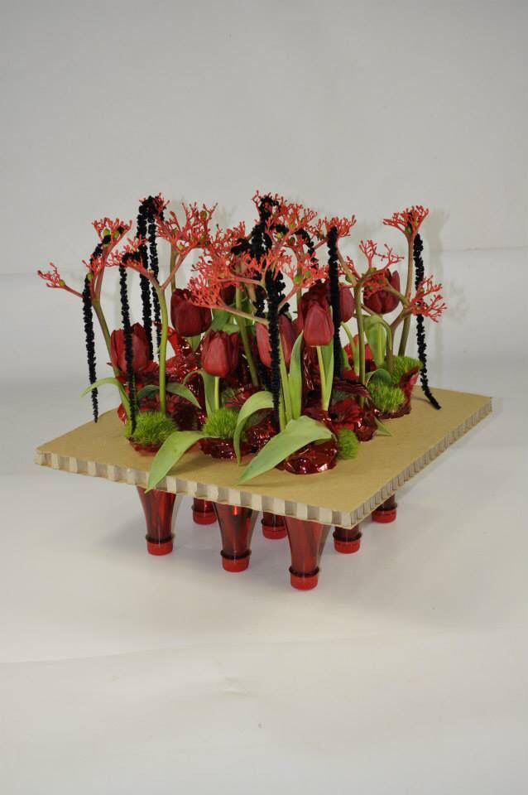
AND FINALY, DON’T let your “recycled” design look like a schoolkid’s art project gone BAD! Oftentimes, LESS is MORE!

Slide 28
April is Blooming with Conservation!
(GCA Judges)
“To leave the world better than you found it, sometimes you have to pick up other people’s trash.” — Bill Nye
Class 1 (4) Entries
Earth Day 2026 - Create a Parallel Design.* Use recycled material for your container and/or accessories; Multiple containers are permitted. Staged on the Riverhouse’s 42” high wooden bar with lip. A 26” high white cloth backdrop and a staging space of 24” width x 18” depth are provided for each design. Viewed and judged from three sides. A Title or Statement of Intent is required.
Class 2 (4) Entries
Novice. Same as above.
“In nature, nothing is perfect and everything is perfect. Trees can be bent, contorted in weird ways, and they’re still beautiful.” – Alice Wade
Class 3 (4) Entries
Arbor Day 2026 - Create a Parallel Design* expressing important elements or features of a tree. Multiple containers are permitted. Staged on the Riverhouse’s 42” high wooden bar with lip. A 26” high white cloth backdrop and a staging space of 24” width x 18” depth are provided for each design. Viewed and judged from three sides. A Title or Statement of Intent is required.
Class 4 (4) Entries
Novice. Same as above.
Pre-registration is required by Sunday, April 19. Class consultant, Louisa Renn, louisarenn@gmail.com. Exhibitors may enter one class only.
SIGN UP ASAP AS SPACES ARE LIMITED!

Slide 29
Thanks to Heather for coordinating the space at the Courthouse and for publicizing the workshop via RGC emails. And, thanks to Mary Jane and Bonnie for their work all year and most recently for brainstorming with me on this presentation. Mary Jane is up next with her design, and I will finish the day showing my attempts at parallel designing. Thanks for coming and we look forward to our April 21, 2026 Flower Show.
QUESTIONS or COMMENTS?

